Slide 1
Coastal Resiliency Planning in Jerusalem Township
Presented by:
Charles Griebling, P.E., CFM
Deanna Bobak
On behalf of the:
Jerusalem Township Trustees
Reno Beach/Howard Farms Conservancy District
December 13, 2023

Slide 2

AGENDA
Project Background
High Priority Results
Next Steps

Slide 3
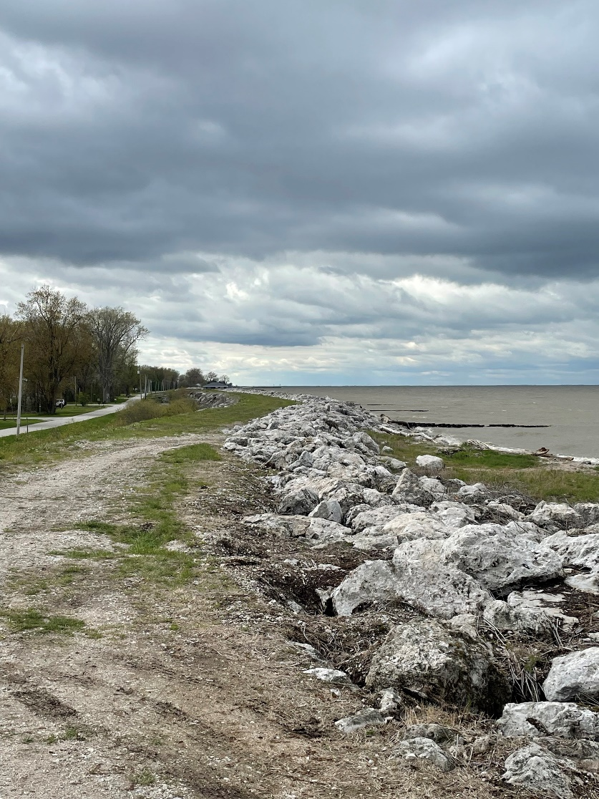
2022: Ohio Lake Erie Commission Coastal Resilience Grant Application
Partnership between Jerusalem Township Government and Reno Beach/Howard Farms Conservancy District
Establishes a framework for risk assessment of the comprehensive levee system
  Includes assessment of both “Project” levee and non-Project levee
  Facilitates a strategic plan for future implementation
  Builds resiliency for future flood events and rising lake levels
Notes:
The activities related to this project are entirely grant-funded and are not being conducted at an additional cost to the residents of Jerusalem Township.
The Township and the Conservancy District motivated to be forward-thinking. The outcome of this grant will help position the Township and CD for future implementation funds.

Slide 4
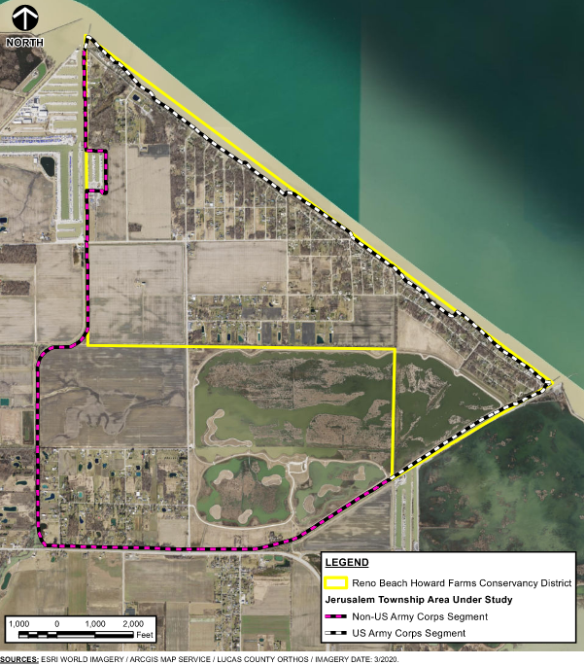
Location Overview Map

Slide 5
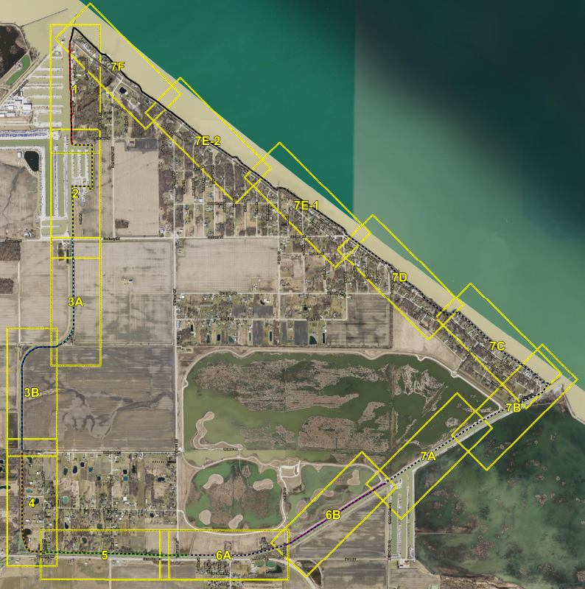
Levee Segment Map

Slide 6
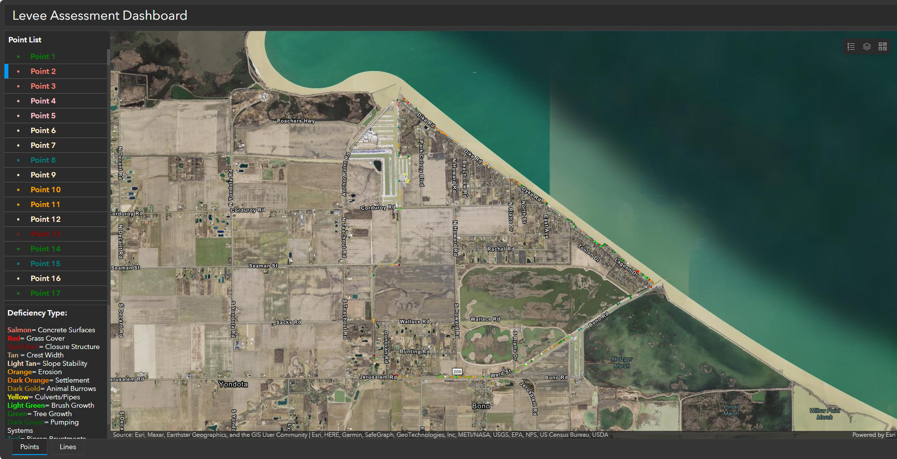
Field Reconnaissance
Vegetative growth
Slope stability
Erosion
Settlement/depression
Bank protection
Animal burrows
Seepage
Infrastructure

Slide 7
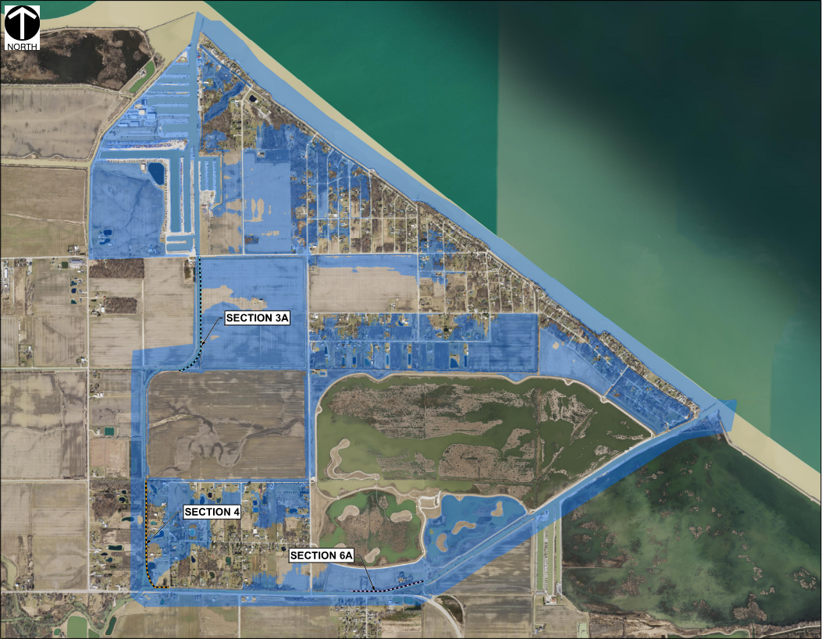
Overtopping Analysis
Utilized 2-Dimensional Hydraulic Modeling Software
Based on OGRIP Topographic Data flown in 2022
Water Surface Elevation Based on FEMA 1% Annual Chance Exceedance
Scenario ran for 48 hours
  Approximate time frame of a Lake Erie Storm Surge event

Slide 8
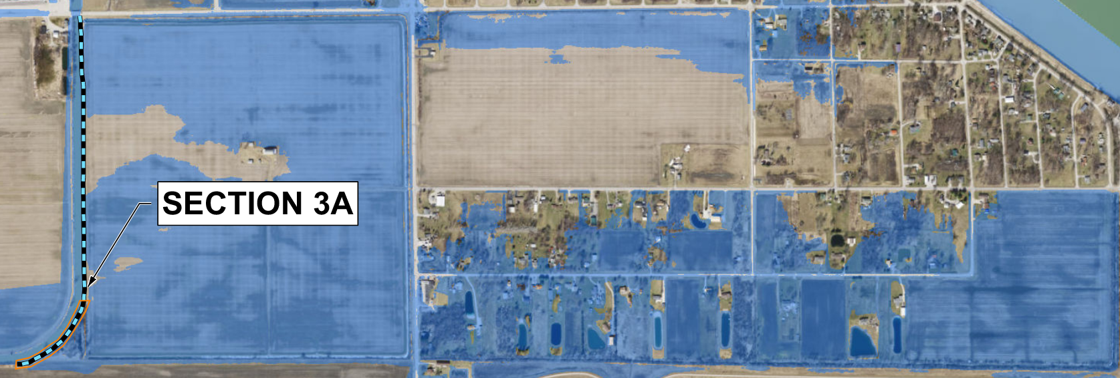
Overtopping Area #1 (Levee Segment 3)

Slide 9
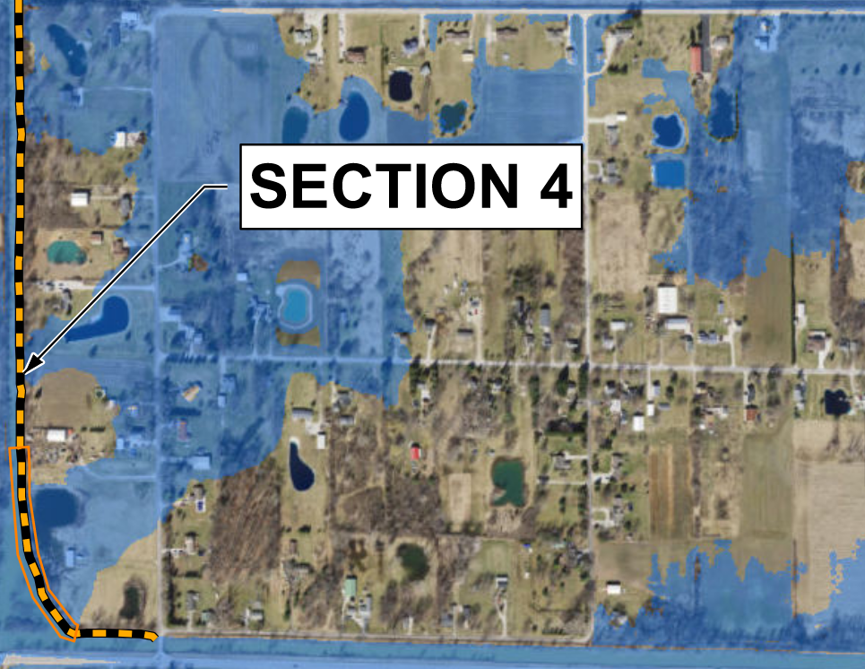
Overtopping Area #2 (Levee Segment 4)

Slide 10
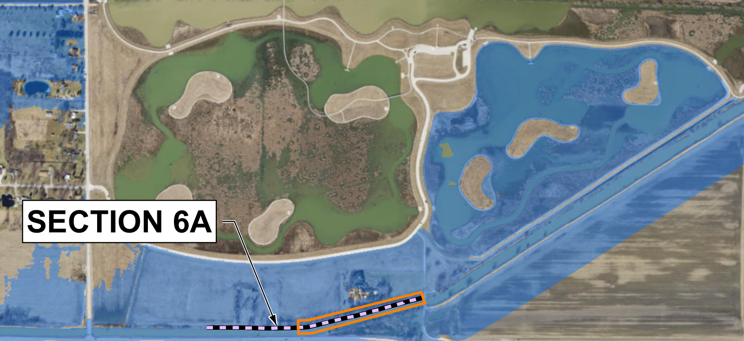
Overtopping Area #3 (Levee Segment 6)

Slide 11
Breach Analysis
Methodology
  Scenarios start with water surface elevation in canals at the FEMA 1% Annual Chance Exceedance water surface elevation
  Steady flow input into canals to simulate storm surge event and to maintain water surface elevation in the canal
  Scenarios ran for 48 hours following breaching the levee
Four Breach Scenarios Analyzed
  At three overtopping locations (Segments 3A, 4, 6A)
  At low point behind the levee system along Wards Canal (Segment 7B)

Slide 12
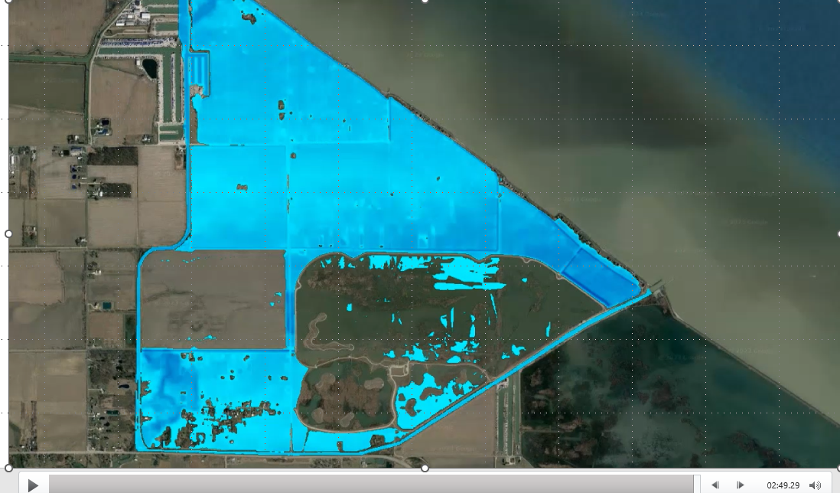
Breach Animation Example

Slide 13
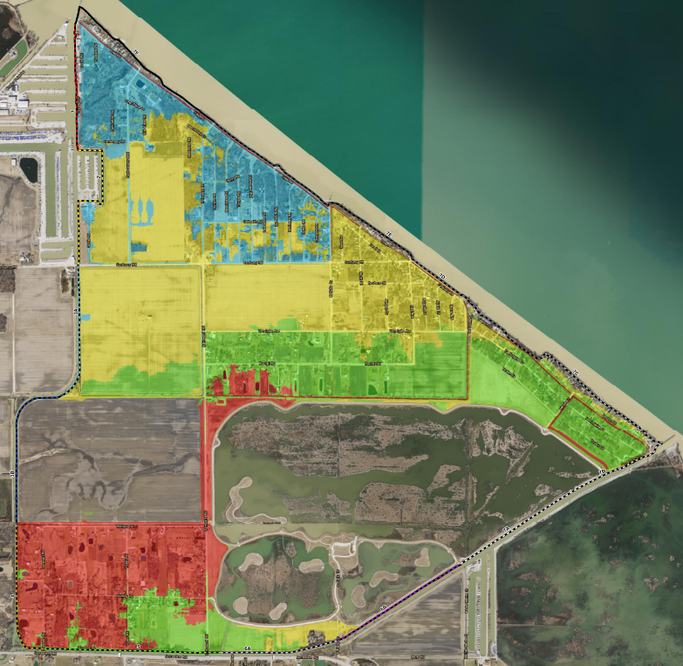
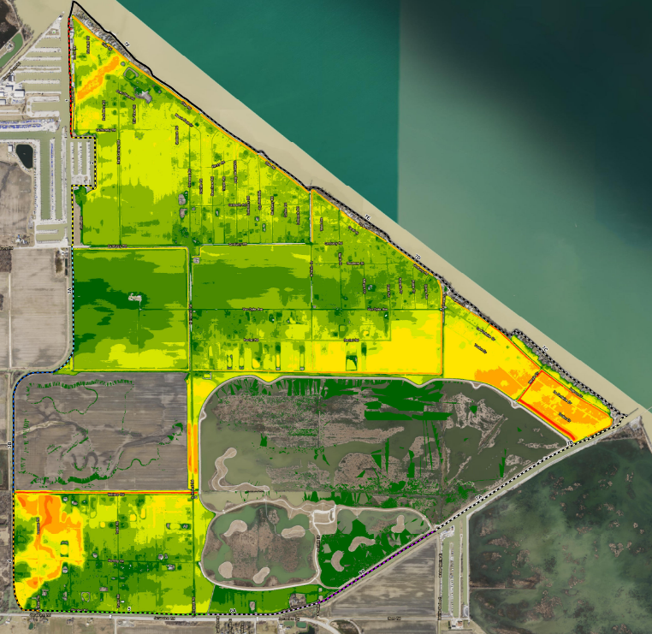
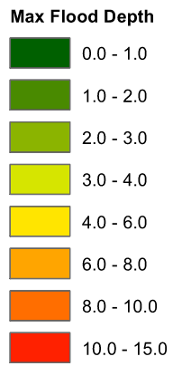
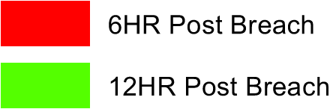
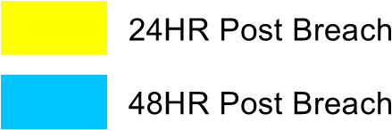
Breach Area 1 (Segment 4)
Extent (after 48 hours)
Maximum Depth (after 48 hours)

Slide 14
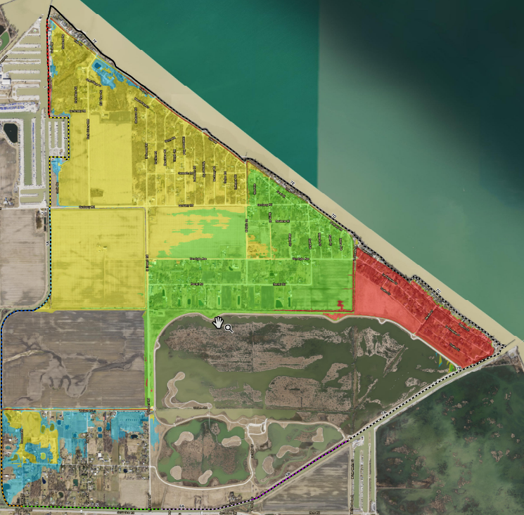
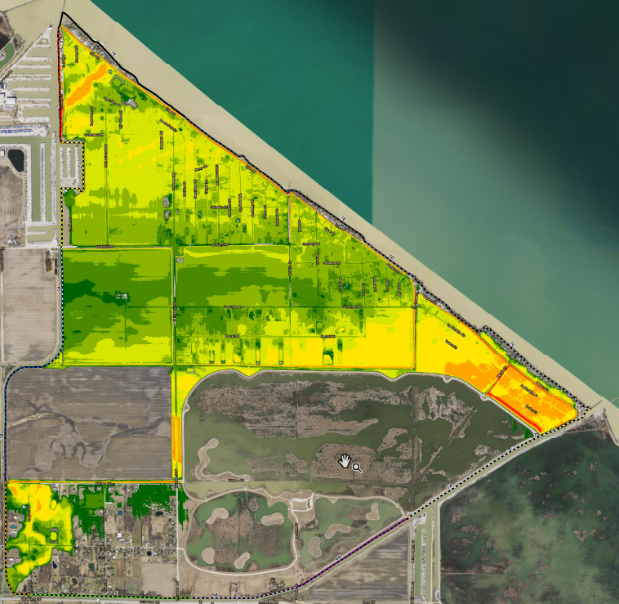
Breach Area 2 (Low Point Behind Levee)
Extent (after 48 hours)
Maximum Depth (after 48 hours)

Slide 15
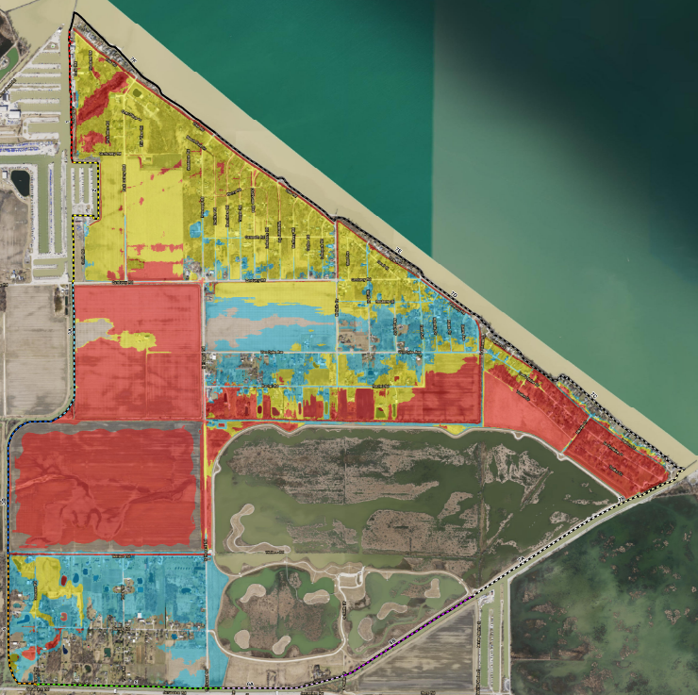
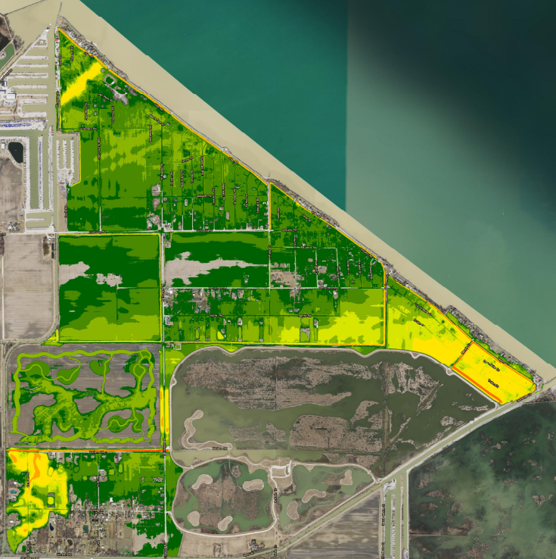
Breach Area 3 (Segment 3)
Extent (after 48 hours)
Maximum Depth (after 48 hours)

Slide 16
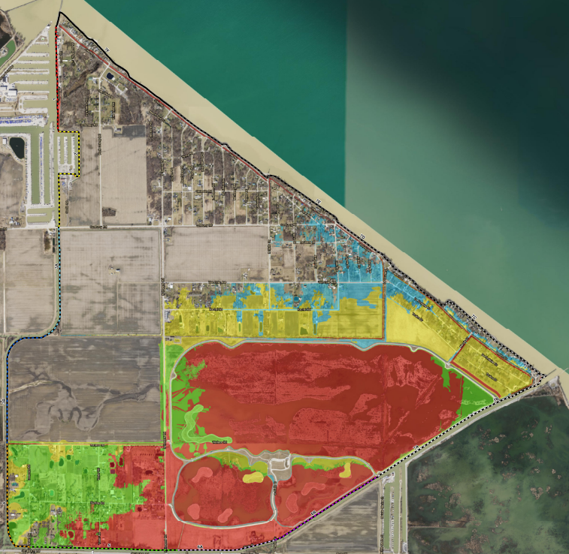
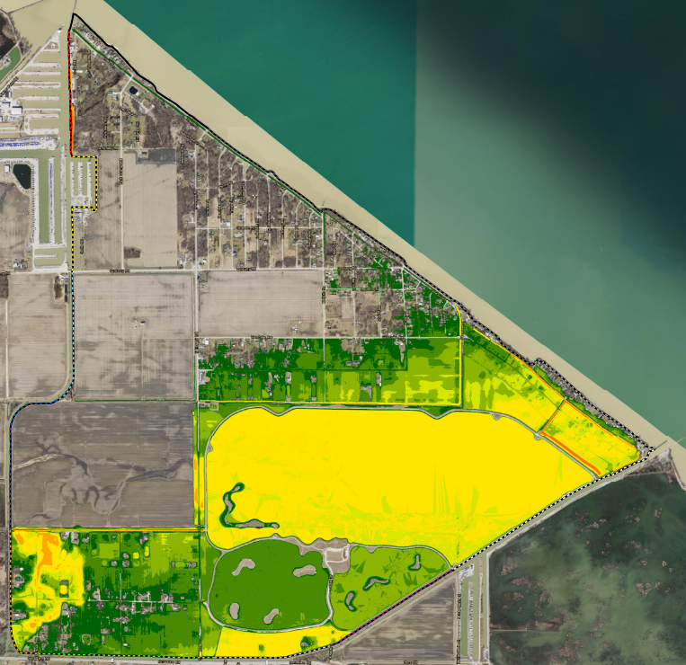
Breach Area 4 (Segment 6)
Extent (after 48 hours)
Maximum Depth (after 48 hours)

Slide 17
Hazard Risk Assessment
Deficiency
Type
  Severity Ranking
  Weight
Hazard Type
  Criticality Ranking
Segment
Attributes
  General Condition
  Length

Slide 18
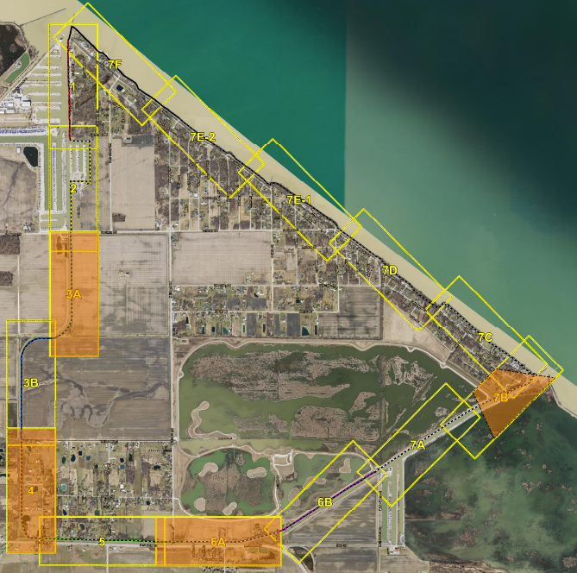
Priority Segments

Slide 19
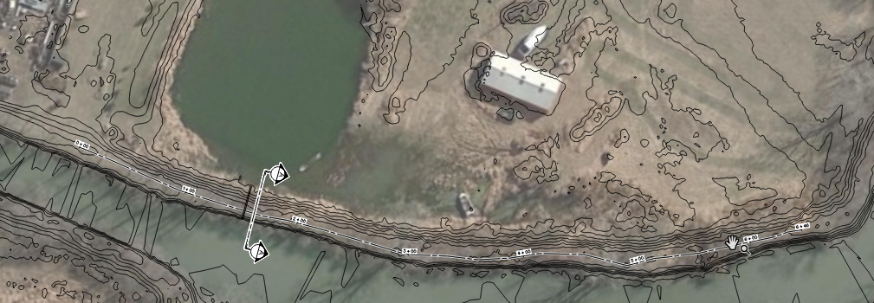
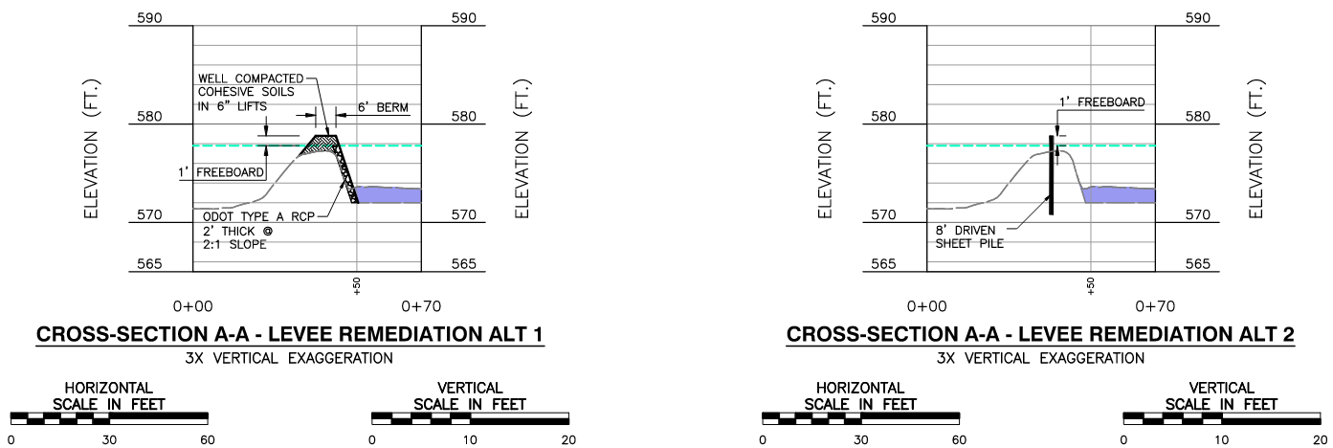
Potential Concepts and Implementation Plan

Slide 20
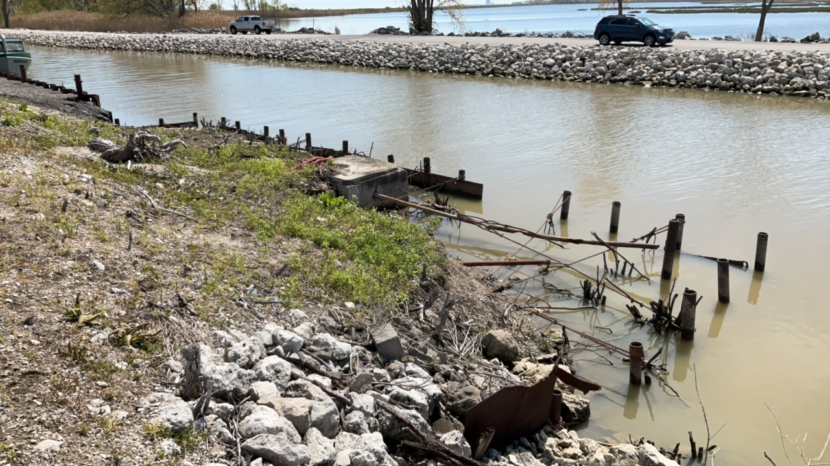
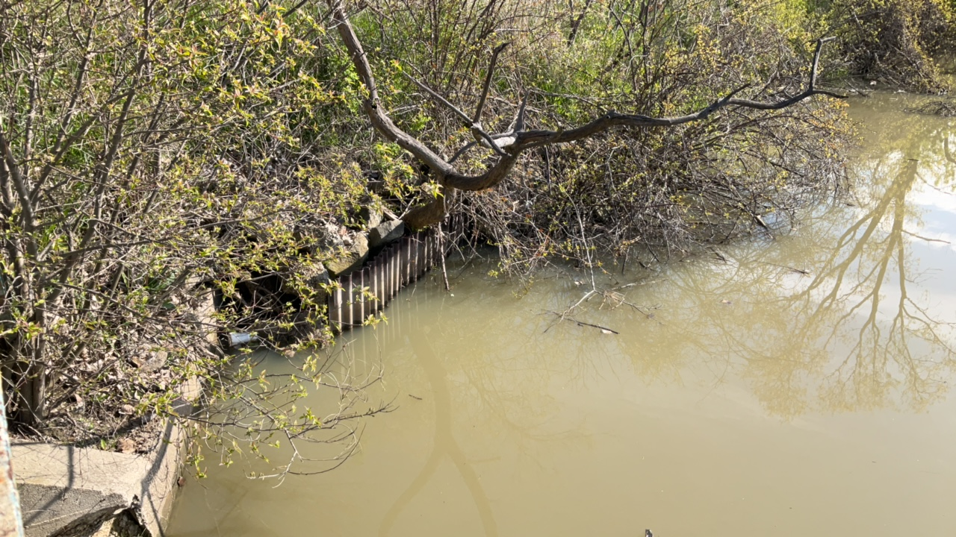
Summary
Finalize the Implementation Plan
  Concepts for high priority segments
  Conceptual level cost opinions
Address most immediate concerns (estimated $2.5M-$3.0M)
  Pursue project funding sources
Continue routine maintenance activities
Monitor lower priority deficiencies

Slide 21
Contact Information
Mark Sattler, Jerusalem Township Trustee
Mark.sattler@twp.jerusalem.oh.us; 419-836-8921
Adam Hoff, Reno Beach/Howard Farms Conservancy District
ahoff@rbhfcd.org; 419-466-3343
Charles Griebling, Civil & Environmental Consultants, Inc.
cgriebling@cecinc.com; 513-985-0226
Deanna Bobak, Civil & Environmental Consultants, Inc.
dbobak@cecinc.com; 419-787-8362

